Slide 1

Digital Transformation in Education
Institutional Effectiveness - Analytics
TDM Deck

Slide 2

Institutional Effectiveness – A Recap

Slide 3



Primary Drivers
Only 26% of a sample of chief academic officers says their institutions are very effective in using data to inform campus decision-making
Only 16% say their institutions are very effective in data analysis and organizational analytics
Evidence-based leadership and management continue to be a growing trend in education institutions

Slide 4
Scenario #1: Student Lifecycle and Success Management
Objective
Scenario | Institutional Effectiveness
Description | Evidence-based analytics school district level dashboard to measure student outcomes, teacher effectiveness and project costs
Target Outcome | Drive overall ROI effectiveness

Slide 5
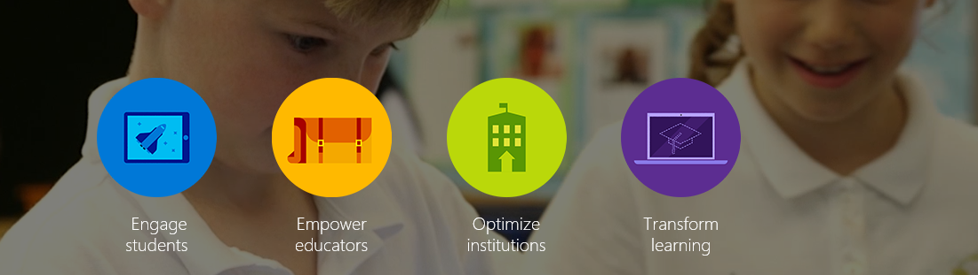
Driving Institutional Effectiveness

Slide 6

Modern Educational Institution
Gain insights into student demographics, staff performance, budget allocations
Help drive student outcomes with a personalized self service experience
Deliver a first-class learning experience with collaborative tools that engage students, staff, and faculty
Improve flexibility, reduce costs, and provide the tools to work efficiently
Business Intelligence
Connected Campus
Engaged Students
Costs, Efficiency & Analytics

Slide 7



Driving Institutional Effectiveness
Create dynamic institutions that inspire students to consume, create knowledge
Administrators
Counselors
Facilities
All up dashboard view across the school district
Driving cost effective education
Improving Student outcomes
Develop data-driven learning plans
Provide always-on education
Protect information without sacrificing communications
Develop meaningful relationships with alumni and other donors
Consolidate all projects and service requests to better manage facilities maintenance
Use data to deliver proactive, cost-effective maintenance
Connect staff across distant facilities

Slide 8
Solution Overview

Slide 9

Drive Student Engagement
Solution Components:
Azure Data Factory
Azure SQL DB
Azure BOT Framework

Slide 10
Counselors have difficulty catering to ever increasing needs of students and suffer from ever -increasing workloads
Build early prevention activities for at-risk students
Determine which concepts a student has mastered and which concepts they struggle with
Counselors can scale up easily by getting an all up view into a student career progression
Counselors
Drive Student Engagement
Solution
Develop a self-service career counselor BOT that personalizes career plans to drive student engagement

Slide 11
Empower Education Administrators
Solution Components:
Azure SQL DB
PowerBI

Slide 12
All up dashboard map view across all schools within the district with ability to drill down with powerful self-service capabilities
Determine Staff and student effectiveness – Identify student dropout profiles and take proactive corrective action
Determine overall costs of all projects across various campuses as part of the school district to measure ROI
Administrators
Empower Education Administrators
Solution
Build reporting systems that presents a consolidated view into student engagement, staff effectiveness and project costs from a facilities perspective across all campuses

Slide 13
Optimize Institutions
Solution Components:
Azure SQL DB
PowerBI

Slide 14
Collect, manage, and analyze maintenance requests to simplify facilities work
Run analytics on requests to understand different scenarios, like repair vs. purchase, and prepare institutions for upcoming expenses.
Scale to more advanced scenarios with connected campuses with Azure IoT solution
Optimize solutions to lower project costs to drive ROI
Facilities
Optimize Institutions
Solution
Build reporting systems that presents a drill-down project based cost view across all connected campuses

Slide 15
Solution – Technology Stack

Slide 16
Big Data + Analytics = Business Value
Data
What should I do?
Decision
Action
Automation
Recommendation
What might happen?
(Predictive Models)
Why did it happen?
{Interactive Dashboards)
What happened?
(Reports)
People & Insights

Slide 17
Azure – Built for Enterprise scale
Enterprise-grade
A trusted cloud – 57% of Fortune 500 companies rely on Azure
A recognized Leader in Gartner Magic Quadrants
Industry-leading commitments to data protection, security measures, privacy policies, and international compliance programs
Hyper-scale
Runs your apps anywhere across 20+ regions
Provides an open and flexible platform from operating systems to coding languages
Delivers scale-as-you-need, pay-as-you-go models via Azure’s near infinite capacity
Hybrid
Extends your existing capabilities
Enables workloads to transition easily across customer sites, service provider datacenters and Azure
Empowers customers to deploy tiered workloads across environments, truly achieving the best of both clouds

Slide 18
Intelligent solutions with Azure
Information Management and data ingestion
Big Data Stores
Intelligence
Data Sources
People
Cognitive Services
Data Factory
Data Lake Store
Bot Framework
Web
Apps
Data Catalog
SQL Data
Warehouse
Cortana
Mobile
Apps
Event Hubs
Azure SQL Database
Bots
Dashboards & Visualizations
Sensors and devices
Automated Systems
Power BI
Data
Intelligence
Action

Slide 19
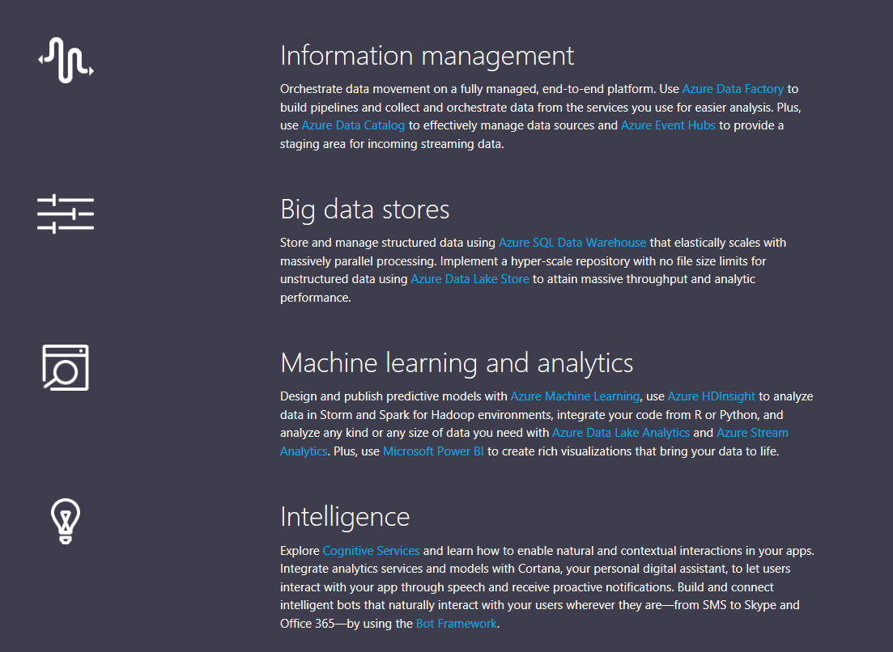
Big Data + Predictive Analytics = Business Value

Slide 20




















Reference Architecture
Reference Architecture
99.9%
On-Premises
SLA
Bots
STORAGE
(Blob)
ANALYSIS
(HDInsight)
STORAGE
(SQL Database)
DATA CONSUMPTION
Data
Management
Gateway
DATA SOURCES
Data Factory Movement Service

Slide 21
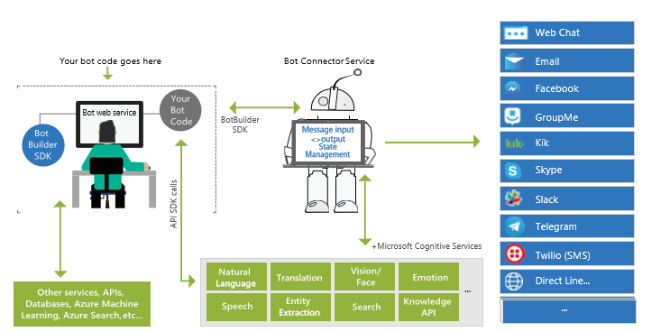
Azure Bot
The Bot Framework is a platform for building and deploying powerful and intelligent bots.
With the Bot Builder SDK and quickly start building bots with the Bot Framework.
In addition, you can take advantage of Microsoft Cognitive Services to add smart features like natural language understanding, image recognition, speech, and more.
Data Lake Store
SQL Data
Warehouse
Azure SQL Database

Slide 22
Data Ingestion and Reporting

Slide 23
Connect and ingest data from different data silo’s
Solution Components:
Azure Data Factory
Azure SQL DB

Slide 24
Ingest data from different SIS, LMS sources from on-premise
Anonymize student data if required
Build early prevention activities for at-risk students
Measure Staff effectiveness
Integrate data across connected campuses to drive project cost metrics and determine ROI effectiveness
Connect and ingest data from different data silo’s

Slide 25
Build reporting systems that drive overall institution effectiveness
Solution Components:
Azure Data Factory
Azure SQL Database
PowerBI

Slide 26
Collect, manage, and analyze maintenance requests to simplify facilities work
Use key metrics to determine student and staff effectiveness
All up dashboard map view across all schools within the district with ability to drill down with powerful self-service capabilities
Determine overall costs of all projects across various campuses as part of the school district to measure ROI
Build reporting systems that drive overall institution effectiveness

Slide 27

Closing

Slide 28
Get started
Start by getting Office 365 for Education for your school:
https://www.microsoft.com/en-us/education/products/office/default.aspx

